Slide 1

JavaScript Chapter 12: Intermediate JavaScript

Slide 2
Introduction
The concepts and solution approaches presented up to this point in the book are not the only way to think about solving issues. In this chapter, we will challenge you to look a little deeper, be curious, and practice the good habit of optimizing solutions.
In previous chapters, you were promised great things about this chapter because the optimal use of some built-in methods require knowledge of regular expressions, which we will cover in this chapter. There is a lot more fun to be had though

Slide 3
Introduction
here is a list of topics that we'll cover:
Regular expressions
Functions and the arguments object
JavaScript hoisting
Strict mode
Debugging
Using cookies
Local storage
JSON
As you can see, a selection of diverse topics, but all advanced and fun. The sections in this chapter are not as related to each other as you might have gotten used to by now. They are mostly individual topics that can help to really enhance your understanding and improve your JavaScript knowledge a lot.

Slide 4
Regular expressions
Regular expressions, also known as regex, are simply ways to describe text patterns. You can consider them next-level strings. There are different regex implementations. This means that depending on the interpreter, regex might differ a bit in the way they're written. However, they are somewhat standardized, so you write them (almost) the same for all versions of regex. We are going to use regex for JavaScript.
Regex can be very useful in many situations, for example when you need to look for errors in a large file or retrieve the browser agent a user is using. They can also be used for form validation, as with regex you can specify valid patterns for field entries such as email addresses or phone numbers.
Regex is not only useful for finding strings, but can also be used for replacing strings. By now you might think, so regex is amazing, but is there a catch? And yes, unfortunately, there is a catch. At first, regex might kind of look like your neighbor’s cat walked over your keyboard and just typed some random characters by accident.
This regex checks for a valid email, for example:
/([a-zA-Z0-9._-]+@[a-zA-Z0-9._-]+\.[a-zA-Z0-9._-]+)/g

Slide 5
Regular expressions
Fear not, after this section, you will be able to decipher the secret patterns within the regex. We are not going to go through everything there is to say about regex, but we will establish a solid level of familiarity that will allow you to work with them and expand your knowledge as you go.
Let's start off easy. The regex pattern is specified between two slashes. This is a valid regex expression:
/JavaScript/
The above expression will match if a given string contains the word JavaScript.
When it matches, this means the result is positive. And this can be used to do many things.
We can use the JavaScript built-in match() function for this. This function returns the regex match on the result (if there is one) in the form of the substring that matched the starting position of this string and the input string.

Slide 6
Regular expressions
There are actually other built-in functions that use regex, but we will see them later. match() is just a convenient function to demonstrate how regex works. You can see it in action here:
let text = "I love JavaScript!";
console.log(text.match(/javascript/));
This logs null because it is case-sensitive by default and therefore is not a match. If we had looked for /ava/ or simply /a/, it would have matched because it contains ava and a. If you want it to be case-insensitive, you can specify this using an i after the slash. In this case-insensitive example, the expression will match the previous string:
console.log(text.match(/javascript/i));

Slide 7
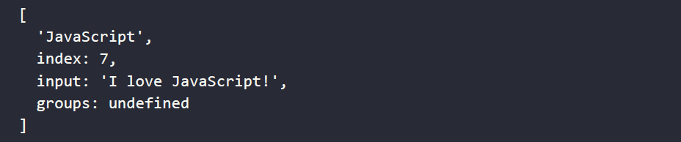
Regular expressions
This will actually log the result, because it is now case-insensitive, and from that point of view, our string does contain javascript. Here is the result:
The result is an object, containing the found match and the index it started on, as well as the input that was looked through. The groups are undefined. You can create groups with round parentheses, as you'll see when we get to the section on groups.
You can often find regex in JavaScript in combination with the built-in search and replace method on strings, which we'll cover next.

Slide 8
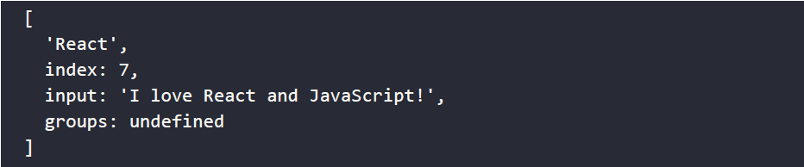
Specifying multiple options for words
In order to specify a certain range of options, we can use this syntax:
let text = "I love JavaScript!";
console.log(text.match(/javascript|nodejs|react/i));
Here, the expression matches either javascript, nodejs, or react. At this point, we are only matching for the first encounter and then we quit. So this is not going to find two or more matches right now—it will output the same thing as before:
let text = "I love React and JavaScript!";
console.log(text.match(/javascript|nodejs|react/i));
It logs this:

Slide 9
Specifying multiple options for words
If we wanted to find all matches, we could specify the global modifier, g. It is very similar to what we did for case-insensitive searches. In this example, we are checking for all matches, and it is case-insensitive. All the modifiers are behind the last slash.
You can use multiple modifiers at the same time as we do below, or you could decide to only use g:
let text = "I love React and JavaScript!";
console.log(text.match(/javascript|nodejs|react/gi));
This returns both React and JavaScript as a result:
As you can see, the result looks very different now. As soon as you specify g, the match function will just return an array of the matching words. This is not too exciting in this case, since these are the words we asked for. But it can be more of a surprise with a more complex pattern. This is exactly what we'll learn next.

Slide 10
Character options
So far, our expressions are quite readable, right? The character options are where things start to look, well, intense. Say we want to search for a string of only one character equal to a, b, or c. We would write it like this:
let text = "d";
console.log(text.match(/[abc]/));
This will return null because d is not a, b, or c. We can include d like this:
console.log(text.match(/[abcd]/));
This will log:

Slide 11
Character options
Since this is a range of characters, we can write it shorter, like this:
let text = "d";
console.log(text.match(/[a-d]/));
And if we wanted any letter, lowercase or uppercase, we would write this:
let text = "t";
console.log(text.match(/[a-zA-Z]/));
We could actually also use the case-insensitive modifier to achieve the same thing, but this would apply to the regex pattern as a whole, and you might only need it to apply for the specific character:
console.log(text.match(/[a-z]/i));
We would get a match on both of the preceding options. If we wanted to include numbers as well, we would write:
console.log(text.match(/[a-zA-Z0-9]/));

Slide 12
Character options
As you can see, we can just concatenate ranges to specify one character, much like we could concatenate possible options for that specific character, like [abc]. The example above specifies three possible ranges. It will match any lowercase or uppercase letter from a to z and all numeric characters as well.
It doesn't mean that it can only match a one-character string by the way; it will just match the first matching character in this case because we didn't add the global modifier. However, these special characters won't match:
let text = "äé!";
console.log(text.match(/[a-zA-Z0-9]/));

Slide 13
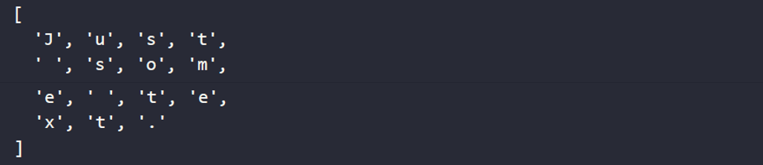
Character options
To address the difficulty of complex characters not matching an expression, the dot functions as a special wildcard character in regex that can match any character. So what do you think this does?
let text = "Just some text.";
console.log(text.match(/./g));
Since it has the global modifier, it is going to match any character. This is the result:

Slide 14
Character options
But what if you only wanted to find a match for the dot character itself? If you want a special character (one that is used in regex to specify a pattern) to have a normal meaning, or a normal character to have a special meaning, you can escape it using the backslash:
let text = "Just some text.";
console.log(text.match(/\./g));
In this example, we escape the dot by adding a preceding backslash. Therefore, it doesn't function as a wildcard and it is going to look for a literal match. This is what it will return:

Slide 15
Character options
There are some normal characters that get a special meaning by adding a backslash before them. We are not going to cover them in depth, but let's have a look at some examples:
let text = "I'm 29 years old.";
console.log(text.match(/\d/g));
If we escape the d, \d, it matches any digit. We are doing a global search so it will specify any digit. This is the result:
We can also escape the s, \s, which matches all whitespace characters:
let text = "Coding is a lot of fun!";
console.log(text.match(/\s/g));
The above example will just return a few spaces, but tabs and other types of whitespace are also included:
[ ' ', ' ', ' ', ' ', ' ' ]

Slide 16
Character options
A very useful one is \b, which matches text only when it's at the beginning of a word. So, in the following example, it is not going to match the instances of in in beginning:
let text = "In the end or at the beginning?";
console.log(text.match(/\bin/gi));
This is what it will end up logging:
Even though you can check for characters being numbers, the match() method belongs to the string object, so you implement it on numeric variables. For example, try the following:
let nr = 357;
console.log(nr.match(/3/g));
You should receive a TypeError saying that nr.match() is not a function.

Slide 17
Groups
There are many reasons to group your regex. Whenever you want to match a group of characters, you can surround them with parentheses. Have a look at this example:
let text = "I love JavaScript!";
console.log(text.match(/(love|dislike)\s(javascript|spiders)/gi));
Here it is going to look for either love or dislike, followed by a whitespace character, followed by javascript or spiders, and it will do so for all occurrences while ignoring whether they are in uppercase or lowercase. This is what it will log:
Let's just say we can match on roughly four combinations here. Two of them seem to make more sense to me personally:
Love spiders
Dislike spiders
Love JavaScript
Dislike JavaScript

Slide 18
Groups
Groups are very powerful when we know how to repeat them. Let's see how to do that. Very often, you'll find yourself in need of repeating a certain regex piece. We have several options for this. For example, if we want to match any four alphanumeric characters in a sequence, we could just write this:
let text = "I love JavaScript!";
console.log(text.match(/[a-zA-Z0-9][a-zA-Z0-9][a-zA-Z0-9][a-zA-Z0-9]/g));
This will produce the following as output:
This is a terrible way to go about repeating a block: let's look for better options. If we only want it to be present 0 or 1 times, we can use the question mark. So this is for optional characters, for example:
let text = "You are doing great!";
console.log(text.match(/n?g/gi));
This looks for a g character that may or not may be preceded by an n. Therefore, this will log:

Slide 19
Groups
Arguably, one time is not really an example of repeating. Let's look at getting more repetitions. If you want something at least once, but optionally more often, you can use the plus sign: +. Here is an example:
let text = "123123123";
console.log(text.match(/(123)+/));
This is going to match for the group 123 one or more times. And since this string is present, it will find a match. This is what will be logged:
It matches the whole string in this case, since it is just 123 repeated. There are also situations where you want to have a certain piece of regex match any number of times, which can be indicated with the asterisk: *. Here is an example regex pattern:

Slide 20
Groups
It will match with any a preceded by 123 any number of times. So it will match on the following, for example:
123123123a
123a
a
ba
The last thing to note about repeating is that we can be more specific as well. We do this using this syntax {min, max}. Here is an example:
let text = "abcabcabc";
console.log(text.match(/(abc){1,2}/));
This will log:

Slide 21
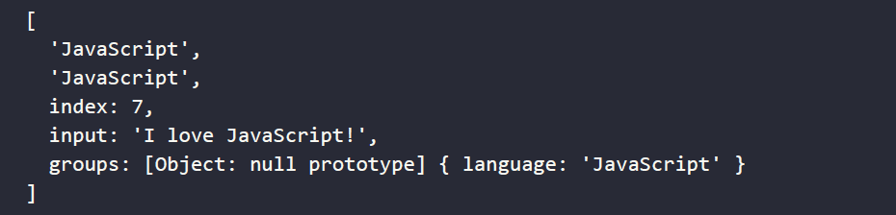
Groups
It does this because it will match on abc both once and twice. As you can see, we have been using groups, but groups is still undefined in the output. In order to specify groups, we'll have to name them. Here's an example of how to do it:
let text = "I love JavaScript!";
console.log(text.match(/(?<language>javascript)/i));
This will output:
There is more to say about regex, but this should already enable you to do quite a lot of cool things with it. Let's have a look at some practical examples.

Slide 22
Practical regex
Regex can be of great use in many situations—anywhere you need to match certain string patterns, regex will come in handy. We are going to discuss how you can use regex in combination with other string methods, and how you can use it to validate email addresses and IPv4 addresses.

Slide 23
Searching and replacing strings
In Chapter 8, Built-In JavaScript Methods, we saw the search and replace methods on strings. We would have liked our search to be case-insensitive, though. Guess what—we can use regex for this!
let text = "That's not the case.";
console.log(text.search(/Case/i));
Adding the i modifier here ignores the distinction between uppercase and lowercase. This code returns 15, which is the starting index position of the match. This cannot be done using the normal string input.
How do you think we can alter the behavior of the replace method using regex in such a way that we can replace all instances rather than the first instance of a string? Again, with a modifier! We use the global modifier (g) for this. To get a feel for the difference, look at this expression without g:
let text = "Coding is fun. Coding opens up a lot of opportunities.";
console.log(text.replace("Coding", "JavaScript"));
This is what it outputs:

Slide 24
Searching and replacing strings
Without regex, it only replaces the first encounter. This time, let's see it with the g global modifier:
let text = "Coding is fun. Coding opens up a lot of opportunities.";
console.log(text.replace(/Coding/g, "JavaScript"));
The result is as follows:
As you can see, all occurrences are replaced.

Slide 25
Practice exercise 12.1
Find and replace strings. The following exercise involves replacing characters in a specified string value. The first input field will indicate which character string will be replaced, and the second input field will indicate which characters will replace them once the button is clicked.
Use the HTML below as a template, and add the JavaScript needed to complete the task:
<!doctype html>
<html>
<head>
<title>Complete JavaScript Course</title>
</head>
<body>
<div id="output">Complete JavaScript Course</div>
Search for:
<input id="sText" type="text">
<br> Replace with:
<input id="rText" type="text">
<br>
<button>Replace</button>
<script></script>
</body>
</html>

Slide 26
Practice exercise 12.1
Take the following steps:
Select each of the three page elements using JavaScript and assign the element objects as variables so that they can be easily referenced in your code.
Add an event listener to the button to invoke a function when clicked.
Create a function named lookup() that will find and replace the text in the output element. Assign the output element's text content to a variable named s, and then assign the value of the input we are replacing to another variable named rt.
Create a new regex with the value of the first input field, which will allow you to replace the text. Using the regex, check for a match with the match() method. Wrap this with a condition that will execute a block of code if matches are found.
If the match is found, use replace() to set the new value.
Update the output area with the newly created and updated text output.

Slide 27
Email validation
In order to create a regex pattern, we need to be able to describe the pattern with words first. Email addresses consist of five parts, in the form of [name]@[domain].[extension]. Here are the five parts explained:
name: One or more alphanumerical characters, underscores, dashes, or dots
@: Literal character
domain: One or more alphanumerical characters, underscores, dashes, or dots
.: Literal dot
extension: One or more alphanumerical characters, underscores, dashes, or dots
So, let's do the steps for regex:
[a-zA-Z0-9._-]+
@
[a-zA-Z0-9._-]+
\. (remember, the dot is a special character in regex, so we need to escape it)
[a-zA-Z0-9._-]+
Putting it all together:
/([a-zA-Z0-9._-]+@[a-zA-Z0-9._-]+\.[a-zA-Z0-9._-]+)/g

Slide 28
Email validation
Let's look at this regex in action:
let emailPattern = /([a-zA-Z0-9._-]+@[a-zA-Z0-9._-]+\.[a-zA-Z0-9._-]+)/g;
let validEmail = "maaike_1234@email.com";
let invalidEmail = "maaike@mail@.com";
console.log(validEmail.match(emailPattern));
console.log(invalidEmail.match(emailPattern));
We tested the pattern on both a valid and an invalid email address, and this is the output:
As you can see, it returns a result for the valid email and it returns null (no match) for the invalid email.

Slide 29
Practice exercise 12.2
Create an application that uses JavaScript to check whether the string value of an input is a validly formatted email using regex. Look at the following template:
<!doctype html>
<html>
<head>
<title>JavaScript Course</title>
</head>
<body>
<div class="output"></div>
<input type="text" placeholder="Enter Email">
<button>Check</button>
<script>
</script>
</body>
</html>

Slide 30
Practice exercise 12.2
Take the following steps:
Use the above template code to start creating your application. Within the JavaScript code, select the input, output, and button elements from the page as JavaScript objects.
Add an event listener to the button to run a block of code when clicked that will get the current value in the input field. Create a blank response value that will populate the output div element contents.
Add a test with the string value from the input field and the expression for email format. If the test result is false, update the response output to say Invalid Email and change the output color to red.
If the condition of the test returns true, add a response that confirms the email format is correct and change the text color of output to green.
Output the response value into the output element.

Slide 31
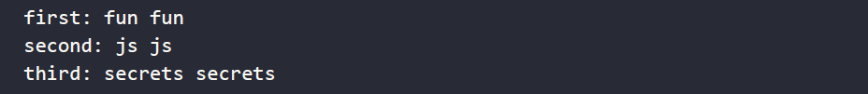
Functions and the arguments object
JavaScript deals with arguments in functions by adding them to a custom object called arguments. This object works a lot like an array, and we can use it instead of using the name of the parameter. Consider the following code:
function test(a, b, c) {
console.log("first:", a, arguments[0]);
console.log("second:", b, arguments[1]);
console.log("third:", c, arguments[2]);
}
test("fun", "js", "secrets");
This outputs:

Slide 32
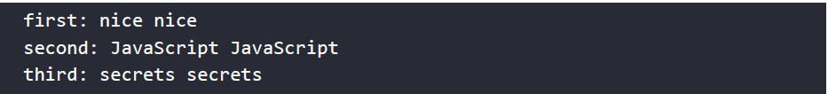
Functions and the arguments object
When you update one of the parameters, the argument gets changed accordingly. The same goes for the other way around;
This is going to change both arguments[0] and b, as they are related to a and arguments[1], respectively, as you can see in the output:
If the function is called with more arguments than were declared in the function signature, this is the way to access them. However, the modern way is to use the rest parameter (…param) instead of the arguments object.
function test(a, b, c) {
a = "nice";
arguments[1] = "JavaScript";
console.log("first:", a, arguments[0]);
console.log("second:", b, arguments[1]);
console.log("third:", c, arguments[2]);
}
test("fun", "js", "secrets");

Slide 33
Practice exercise 12.3
This exercise will demonstrate using the array-like arguments object and extracting values from it. Using the arguments length property, we will iterate through the items in the arguments and return the last item in the list:
Create a function without any parameters. Create a loop to iterate through the length of the arguments object. This will allow an iteration of each item of the arguments in the function.
Set up a variable called lastOne with a blank value.
As you loop through the arguments, set lastOne to the current value of the argument using the index of i to return the argument value. The argument will have an index value that can be used to reference the value as you iterate through the arguments object.
Return the value of lastOne, which should only return the last argument value as the response.
Output the response from the function, pass a number of arguments into the function, and console log the response result. You should see only the last item in the list. If you want to see each one, you can output them separately to the console as you look through the values, or construct an array that can then be returned, adding each one as you go through the arguments.

Slide 34
JavaScript hoisting
In Chapter 6, Functions, we discussed that we have three different variables, const, let, and var, and we highly recommended that you should use let instead of var because of their different scopes. JavaScript hoisting is why. Hoisting is the principle of moving declarations of variables to the top of the scope in which they are defined.
This allows you to do things that you cannot do in many other languages, and for good reason by the way. This should look normal:
var x;
x = 5;
console.log(x);
It just logs 5. But thanks to hoisting, so does this:
x = 5;
console.log(x);
var x;

Slide 35
JavaScript hoisting
If you try to do this with let, you'll get a ReferenceError. This is why it is better to use let. Because clearly, this behavior is very hard to read, unpredictable, and you don't really need it.
The reason this happens is that the JavaScript interpreter moves all the var declarations to the top of the file before processing the file. Only the declarations, not the initializations. This is why you get a result of undefined if you use it before having initialized it. And this is why it should be initialized before it has been declared. It was designed this way for memory allocation, but the side effects are undesirable.
However, there is a way to turn this behavior off. Let's see how we can do so in the next section!

Slide 36
Using strict mode
We can change the understanding and forgiving behavior of JavaScript to some extent using strict mode. You can switch on strict mode with the following command in your code. This needs to be the first command of your code:
"use strict";
Here is something that works when we don't use strict mode:
function sayHi() {
greeting = "Hello!";
console.log(greeting);
}
sayHi();

Slide 37
Using strict mode
We forgot to declare greeting, so JavaScript did it for us by adding a greeting variable to the top level and it will log Hello!. If we enable strict mode, however, this will give an error:
"use strict";
function sayHi() {
greeting = "Hello!";
console.log(greeting);
}
sayHi();
The error:

Slide 38
Using strict mode
You can also use strict mode only in a particular function: simply add it to the top of the function and it gets enabled for that function only. Strict mode alters a few other things too; for example, when using strict mode, there are fewer words that can be used as names for your variables and functions because they are likely to become reserved keywords in the future that JavaScript will need for its own language.
Using strict mode is a great way of getting used to using JavaScript in the setting of frameworks or even for writing TypeScript later. It is typically considered a good practice nowadays, so we would encourage you to use this in your own code when you have the chance. This is often not an (easy) option when working with existing older code though.
Now we have seen strict mode, it's time to dive into a whole different mode: debug mode! Debug mode is for when you are not busy writing or running your application, but are running it in a special way to spot the locations of any errors.

Slide 39
Debugging
Debugging is a delicate art. In the beginning, it usually is very hard to spot what’s wrong with your code. If you are using JavaScript in the browser and it is not behaving as you would expect, step 1 is always to open the console in the browser.
Often it will contain errors that can help you further.
If that doesn't solve it, you can log to the console in every step of your code, and also log the variables. This will give you some insight as to what is going on. It might just be that you are relying on a certain variable that happens to be undefined. Or perhaps you are expecting a certain value from a mathematical computation, but you've made an error and the result is something completely different from what you thought. Using console.log() during development to see what's happening is rather common.

Slide 40
Breakpoints
A more professional way to go about debugging is to use breakpoints. This can be done from most browsers and IDEs. You click on the line before your code (in the Sources panel in Chrome, but this may be different for different browsers), and a dot or arrow will appear. When your application is running, it will pause at this point to give you the opportunity to inspect the values of variables and walk through the code line by line from there.
This way, you will get a good clue of what is going on and how to fix it. Here is how to use breakpoints in Chrome, and most other browsers have something like this. In Chrome, go to the Sources tab of the Inspect panel. Select the file you want to set a breakpoint in. Then you just click on the line number and it sets the breakpoint:
Figure 12.1 On the next slide →

Slide 41
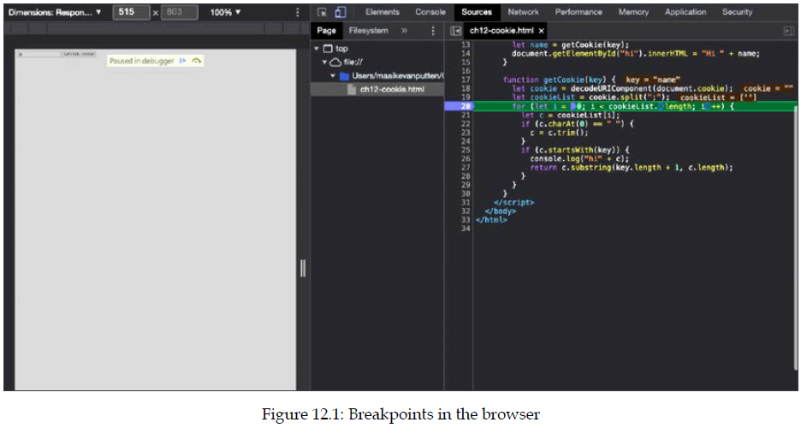
Breakpoints

Slide 42
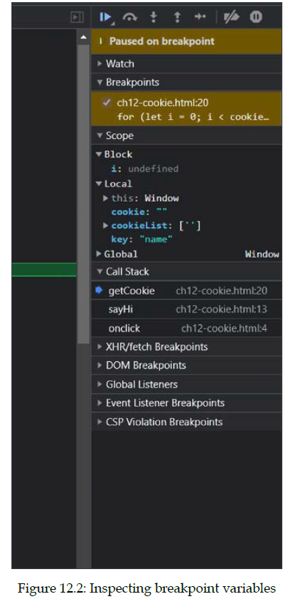
Breakpoints
Then try to trigger the line of code, and when it gets triggered, it pauses. On the very right of the screen I can inspect all the variables and values:
You can now go through your code with a fine-toothed comb: with the play icon on top, you can resume script execution (until it hits the next breakpoint or runs in to the same breakpoint again). With the round arrow icon at the top, I can go to the next line and inspect the values on the next line again.

Slide 43
Practice exercise 12.4
Variable values can be tracked in the editor while debugging. The following exercise will demonstrate how to use the editor's breakpoints to check a value of a variable at a certain point in the running of the script. This is a simple example, but the same process can be used to find out information about larger scripts at specific points during execution, or establish where a problem may lie.
You can use the following short script as an example:
let val = 5;
val += adder();
val += adder();
val += adder();
console.log(val);
function adder(){
let counter = val;
for(let i=0;i<val;i++){
counter++;
}
return counter ;
}

Slide 44
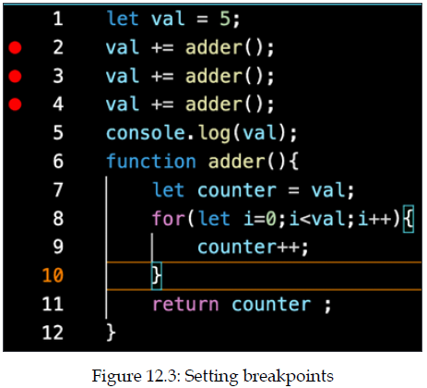
Practice exercise 12.4
This exercise has been tested in a desktop editor but it is equally relevant to browser consoles and other environments. Take the following steps:
Open your script in your chosen editor, or the Sources tab of your browser’s Inspect panel. Click to the left of the line of code where you want to add a breakpoint. A dot or other indicator will appear to indicate the breakpoint is set:

Slide 45
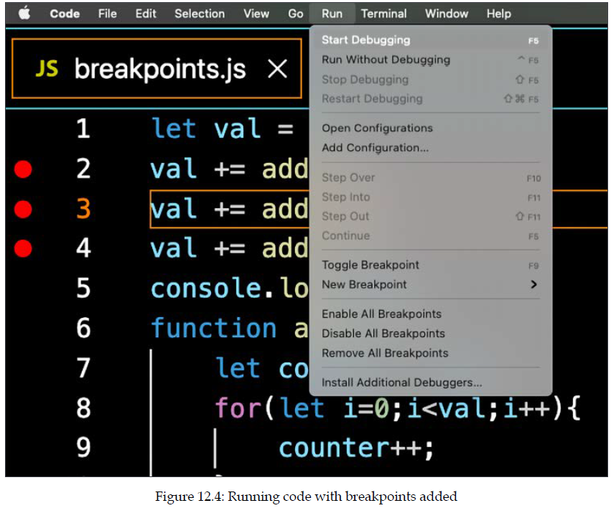
Practice exercise 12.4
Run the code with your new breakpoints: I have selected Run | Start Debugging, but this will vary depending on your editor. You can simply reload the web page if you're using the browser console to rerun the code with your new breakpoints accounted for:

Slide 46
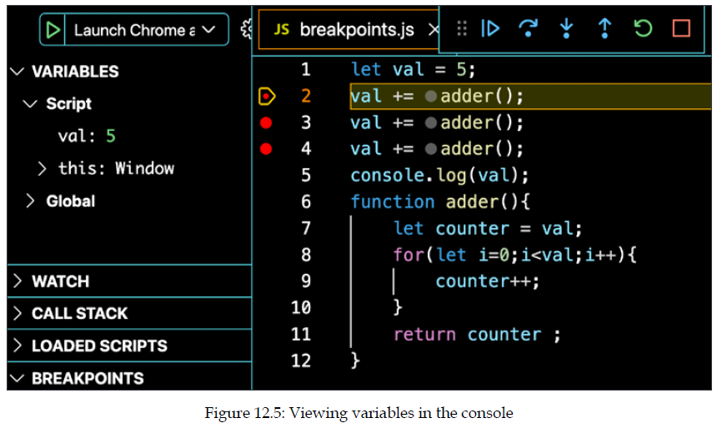
Practice exercise 12.4
You should now see the debugging console. There will be a tab that lists the variables in the code and the current values at the first breakpoint. It's called VARIABLES in my editor, but it's the Scope tab in the Chrome browser console.
You can use the menu options to move to the next breakpoint, stop debugging, or restart the breakpoint sequence. Press the play icon to move to the next breakpoint. It will update to have a value of 5, as specified by line 1, and pause at the first breakpoint. Note that the highlighted line has not been run yet:

Slide 47
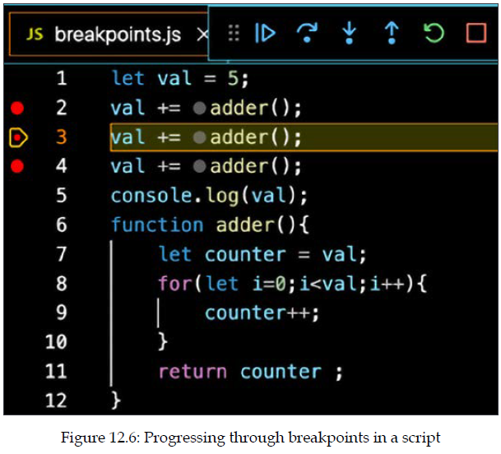
Practice exercise 12.4
Press the play icon once more, and the script will run until it hits the next breakpoint, at which point the value of the variable will update as a result of the code on line 2:

Slide 48
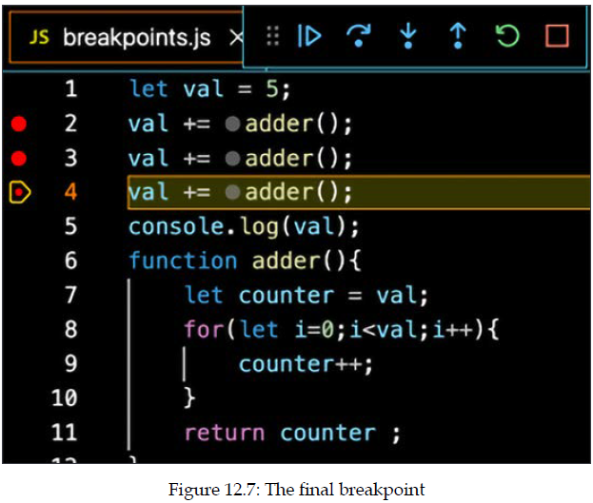
Practice exercise 12.4
Press play again to move to the next breakpoint, which increases the value of val once more:

Slide 49
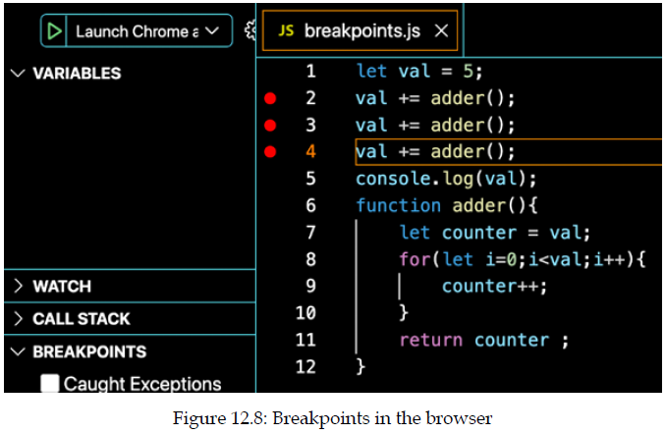
Practice exercise 12.4
Once the last breakpoint is reached you will only see options to restart or stop the debugger. If you press stop, it will end the debugging process:
The final value of val after the third breakpoint was revealed as 135. Write down the values of val after the first and second calls to the adder() function, which were revealed to you by using breakpoints.

Slide 50
Error handling
We have seen a lot of errors appear already. Until now, we let the program crash when it encountered an error. There are other ways to deal with errors. When we are dealing with code that depends on some sort of outside input, such as an API, user input, or a file we will need to deal with the errors that this input can cause.
If we expect a certain piece of code to throw an error, we can surround this code with a catch block. The error it might throw will be caught in this block.
Here is an example of a piece of code that throws an error, and is surrounded with a try and catch block. Let's assume the somethingVeryDangerous() function might throw errors:
try {
somethingVeryDangerous();
} catch (e) {
if (e instanceof TypeError) {
// deal with TypeError exceptions
} else if (e instanceof RangeError) {
// deal with RangeError exceptions
} else if (e instanceof EvalError) {
// deal with EvalError exceptions
} else {
//deal with all other exceptions
throw e; //rethrow
}
}

Slide 51
Error handling
If it throws an error, it will end up in the catch block. Since Error could mean many different errors, we are going to check for the exact error we are dealing with and write a specific handling of this error. We check the exact error class with the instanceof operator. After the error handling, the rest of the code will continue to execute normally.
You can do one more thing with a try catch block, and that is add a finally block. This finally block gets executed irrespective ofwhether errors are thrown. This is great for cleanup purposes. Here is a simple example:
We don't know the output of this code, since trySomething() is not defined. If it were to throw an error, it would log Oh oh to the console and then Error or no error, I will be logged!. If trySomething() didn't throw an error, it would only log the last part.
try {
trySomething();
} catch (e) {
console.log("Oh oh");
} finally {
console.log("Error or no error, I will be logged!");
}

Slide 52
Error handling
Lastly, if, for whatever reason, you need to throw an error, you can do so with the throw keyword, like this:
This can be of great use whenever you need to deal with things out of your control, such as an API response, user input, or input from reading a file. If unexpected things happen, sometimes you'll have to throw an error to deal with it appropriately.
function somethingVeryDangerous() {
throw RangeError();
}

Slide 53
Practice exercise 12.5
Using throw, try, and catch, check if the value is a number, and if it's not, then create a custom error.
Create a function with one argument called val.
Use try, and within it add a condition that checks whether val is a number using isNaN. If true, then throw an error that states that it is not a number. Otherwise, output Got a number to the console.
Use catch to catch any errors and output the error values to the console.
Add finally to run and output the value, and when the function has completed, also include the value of val.
Create one request to the function with a string argument and another with a number. See the results in the console.

Slide 54
Using cookies
Cookies are small data files that are stored on your own computer and used by websites. Cookies were invented to store things about the user of the website. Cookies are strings with a special pattern. They contain key-value pairs, and these key-value pairs are separated by semi-colons.
You can create a cookie and use it again later. Here is how you can create a cookie:
This does not work in all browsers when you run it on the client side (such as in your <script> tag). In Chrome, for example, you cannot set the cookies from the client side. You have to run the code from a server. (I have used Safari instead to do this here, but there are no guarantees about future support.) An alternative is the web storage API.
document.cookie = "name=Maaike;favoriteColor=black";

Slide 55
Using cookies
It is also possible to start Chrome from the command line with certain settings enabled or to enable the cookies in the settings under privacy preferences. Be careful to turn this off afterward if you don't want it, though. This is how you can read from the cookie:
This example gets all the cookies using decodeURIComponent(), and then splits them on the ;. This leaves us with an array, cookieList, with key-value pairs as strings. Next, we loop over all the key-value pairs. Trim them (remove the whitespace in front and at the back), and see whether they start with name. This was the name of our cookie key.
let cookie = decodeURIComponent(document.cookie);
let cookieList = cookie.split(";");
for (let i = 0; i < cookieList.length; i++) {
let c = cookieList[i];
if (c.charAt(0) == " ") {
c = c.trim();
}
if (c.startsWith("name")) {
alert(c.substring(5, c.length));
}
}

Slide 56
Using cookies
If we want to get the value, we have to start reading after the key, so at least the length of the key, which is 4 (name) in this case. This brings us to index 3 already. We also want to skip the equal sign on index 4, so we start at index 5. In this case, we are adding an alert to the name. Here is an example of a simple website that uses a cookie to greet the user:
<!DOCTYPE html>
<html>
<body>
<input onchange="setCookie(this)" />
<button onclick="sayHi('name')">Let's talk, cookie!</button>
<p id="hi"></p>
<script>
function setCookie(e) {
document.cookie = "name=" + e.value + ";";
}
function sayHi(key) {
let name = getCookie(key);
document.getElementById("hi").innerHTML = "Hi " + name;
}
Continues →

Slide 57
Using cookies
If you are writing a new website, you probably should not be using this. However, whenever you need to work with older code, chances are you'll come across this. And now you know what it means and how to adjust it. Good for you!
function getCookie(key) {
let cookie = decodeURIComponent(document.cookie);
let cookieList = cookie.split(";");
for (let i = 0; i < cookieList.length; i++) {
let c = cookieList[i];
if (c.charAt(0) == " ") {
c = c.trim();
}
if (c.startsWith(key)) {
console.log("hi" + c);
return c.substring(key.length + 1, c.length);
}
}
}
</script>
</body>
</html>

Slide 58
Practice exercise 12.6
Let's make a cookie builder. Create several functions that will allow you to interact with page cookies, including reading a cookie value by name, creating a new cookie using a name and setting it for a set number of days, and deleting a cookie. You can use the following HTML template to get you started:
<!doctype html>
<html>
<head>
<title>Complete JavaScript Course</title>
</head>
<body>
<script>
</script>
</body>
</html>

Slide 59
Practice exercise 12.6
Take the following steps:
Set up your webpage, and in the JavaScript code, output the value of document.cookie. It should be blank.
Create a function that will take the parameters for cookieName, cookieValue, and the number of days you want to set the cookie.
Check if days is valid, and within the block of valid code, get the current date. Set a setTime value for the cookie to expire in milliseconds by multiplying the days into milliseconds.
Change the date object of milliseconds until the cookie expires to a UTC string value.
Set document.cookie to cookieName = cookieValue, plus add the expiry details and lastly specify path=/.
Create a function to create a test cookie with a value and expiry set after a number of days. Create a second cookie the same way, and when you refresh your page, you should see at least two cookies in the console.
Continues →

Slide 60
Practice exercise 12.6
Create a second function to read a cookie value, set the value as false, and then create an array of the cookies split by semi-colons.
Loop through all the cookies and split again where the equal signs are. This will give you the first item with index 0 as the name of the cookie. Add a condition to check if the name is equal to the name that was requested in the function parameters. If it matches, assign the value of the second item in the index, which will be the value of the cookie with the selected name. Return cookievalue in the function.
Add two console log messages using the function to read both cookies you have set earlier. Output the values of the cookies in the console.
To delete a cookie, you need to set a date prior to the current date. You can create a cookie with a -1 date and send the cookie with its selected name to be deleted by invoking the cookie creation function.
Try deleting a cookie by name.

Slide 61
Local storage
We have looked at cookies as a way to save user data, but there is actually a more modern way to do this: local storage. Local storage is an amazing fun topic that will add to your ability to make smart websites. With local storage, we can save key-value pairs in our web browser and use them again in a new session (when the browser is opened again later). The information is typically stored in a folder on the computer of the user, but this differs a bit by browser.
This allows the website to store some information and retrieve it later, even after refreshing the page or closing the browser. The advantage of local storage over cookies is that they don't need to be passed around with every HTTP request, which is the case with cookies. Local storage just lives there and waits to be accessed.

Slide 62
Local storage
The localStorage object is a property of the window object that we have seen before. There are a few methods on the localStorage object that we need to know to use it effectively. First of all, we need to be able to get and set key-value pairs on local storage. We use setItem() whenever we want to save something and getItem() whenever we want to retrieve the value later. Here is how to do it:
<!DOCTYPE html>
<html>
<body>
<div id="stored"></div>
<script>
let message = "Hello storage!";
localStorage.setItem("example", message);
if (localStorage.getItem("example")) {
document.getElementById("stored").innerHTML = localStorage.getItem("example");
}
</script>
</body>
</html>

Slide 63
Local storage
This code snippet outputs Hello storage! on the page. You can add items to storage by specifying a key and a value with the setItem method. You can access localStorage directly or via the window object. Here we specify example as the key and Hello storage! as the value and save it to local storage. Then we check whether the example key is set in local storage and output the data by writing it to the innerHTML of the div with the ID stored.
If you go back to your code and turn off the setItem() line before loading the page a second time, it still will output that value, since the information was stored when running the script the first time and never got deleted. Local storage doesn't expire, though it can be manually deleted.

Slide 64
Local storage
We can also retrieve a key using the index. This is useful whenever we need to loop through the key-value pairs and we don't know the names of the keys. This is how to retrieve a key by index:
window.localStorage.key(0);
In this case, the key is name. In order to get the associated value, we can do this:
window.localStorage.getItem(window.localStorage.key(0));
We can also remove key-value pairs like this:
window.localStorage.removeItem("name");
And we can remove all the key-value pairs from the local storage in one call:
window.localStorage.clear();

Slide 65
Local storage
So, with local storage you can save values even after closing the browser. This allows for a lot of "smart" behavior, since your app is now able to remember things, such as what you've entered in a form, which settings you've toggled on a website, and what you've looked at previously.
Please don't see this as an alternative that you can use to bypass the problems with cookies and privacy. Local storage raises the exact same issues as cookies, it's just less known. You will still have to mention on your website that you are tracking users and storing information, just like you need to do for cookies.

Slide 66
Practice exercise 12.7
<!doctype html>
<html>
<head>
<title>JavaScript</title>
<style>
.ready {
background-color: #ddd;
color: red;
text-decoration: line-through;
}
</style>
</head>
<body>
<div class="main">
<input placeholder="New Item" value="test item" maxlength="30">
<button>Add</button>
</div>
<ul class="output">
</ul>
<script>
</script>
</body>
</html>
Let's create a local storage shopping list that will store values in the browser's local storage. This is an example of using JavaScript to convert from strings to useable JavaScript objects and back to strings that can be stored in local storage. You can use the following template:

Slide 67
Practice exercise 12.7
Take the following steps:
In the JavaScript code, select all the page elements as JavaScript objects.
Create a tasks array with a value of the local tasklist storage if it exists, otherwise set the tasks array to an empty array. Using JSON.parse, you can convert the string value to a useable object in JavaScript.
Loop through all the items in the tasklist array; they will be stored as objects, with a name and a Boolean value for their checked status. Create a separate function to build the task item, adding it to the page from the list.
In the task generation function, create a new list item and a textNode. Append textNode to the list item. Append the list item to the page output area. If the task is marked complete with a Boolean value of true, then add the style class of ready.
Continues →

Slide 68
Practice exercise 12.7
Add an event listener to the list item that will toggle the ready class when clicked. Every time there is a change to any list item, you will also need to store that to the local storage. Create a task builder function that will store and ensure the visual list is the same as the local storage list. You will need to clear the current task list array and rebuild from the visual data, so create a function to handle the list building.
The task builder function will clear the current tasks array, and select all the li elements on the page. Loop through all the list items, getting the text value from the element, and checking if it contains the class of ready. If it contains the ready class, then mark the checked condition as true. Add the results to the tasks array, and this will rebuild the array to ensure it matches with what the user sees visually. Send to a save tasks function to save the tasks array in local storage, so if the page is refreshed, you will see the same list.
In the save tasks function, set the localstorage item to the tasks array. You will need to stringify the object so that it can go into the string parameter of local storage.
Now, when you refresh the page, you will see the list of tasks. They can be crossed out by clicking them and new items can be added in the input field by pressing the button to submit new items.

Slide 69
JSON
JSON stands for JavaScript Object Notation, which is nothing more than a data format. We saw this notation when we were creating our objects in JavaScript; however, JSON doesn't mean JavaScript objects, it's just a way of representing data using a similar format as JavaScript objects. It can also be easily converted to a JavaScript object.
JSON is a standard used to communicate with APIs, including APIs that aren’t written in JavaScript! APIs can accept data, for example, the data from a form on a website, in JSON format. And nowadays, APIs almost always send data back in JSON. Sending data from an API happens, for example, when you enter a web shop—the products typically come from a call to an API that is connected to a database. This data gets converted to JSON and is sent back to the website. Here is an example of JSON:
{
"name": "Malika",
"age": 50,
"profession": "programmer",
"languages": ["JavaScript", "C#", "Python"],
"address": {
"street": "Some street",
"number": 123,
"zipcode": "3850AA",
"city": "Utrecht",
"country": "The Netherlands"
}
}

Slide 70
JSON
This is an object that seems to describe a person. It has key-value pairs. The keys always have to be between quotes, but the values only have to be between quotes when they are strings. So, the first key is name and the first value is Malika.
Lists of values (or JavaScript arrays) are indicated with []. The JSON object contains a list of languages, which has the square brackets, and another object, address. You can tell this by the curly brackets.
There are actually only a few flavours in JSON:
Key-value pairs with values of the following types: string, number, Boolean, and null
Key-value pairs with lists, which have [ and ] that contain the items in the list
Key-value pairs with other objects, which have { and } that contain other JSON elements
These three options can be combined, so an object can contain other objects and a list can contain other lists. We saw this already in the above example. Our object contained a nested address object.

Slide 71
JSON
But this can be nested even further. A list can also contain objects, which can contain lists with objects, with lists, and so on. This might sound a bit complicated and that's exactly the point. Even though it is very simple, nesting all these options can still complicate JSON a bit. There is a reason we've placed it in our advanced topic chapter.
Let's now have a look at a slightly more complex example:
{
"companies": [
{
"name": "JavaScript Code Dojo",
"addresses": [
{
"street": "123 Main street",
"zipcode": 12345,
"city" : "Scott"
},
{
"street": "123 Side street",
"zipcode": 35401,
"city" : "Tuscaloosa"
}
]
},
Continues →

Slide 72
JSON
This is a list of companies, with two company objects on it. The companies have two key-value pairs: a name and an address list. Each of the address lists contains two addresses, and each address consists of three key-value pairs: street, zipcode and city.
{
"name": "Python Code Dojo",
"addresses": [
{
"street": "123 Party street",
"zipcode": 68863,
"city" : "Nebraska"
},
{
"street": "123 Monty street",
"zipcode": 33306,
"city" : "Florida"
}
]
}
]
}

Slide 73
Practice exercise 12.8
This exercise will demonstrate how you can create a valid JSON object that can be used as a JavaScript object. You will create a simple list of names and statuses that can be looped through and output the results to the console. You will load JSON data to JavaScript and output the results of the object's contents:
Create a JavaScript object that contains JSON formatted data. The object should contain at least two items and each item should be an object with at least two paired values.
Create a function that can be invoked that will loop through each item in the JavaScript JSON object and output the result to the console. Output each item of data to the console using console.log.
Invoke the function and launch the JavaScript code.

Slide 74
Parsing JSON
There are many libraries and tools available for parsing a JSON string into an object. A JavaScript string can be converted to a JSON object using the JSON.parse() function. Data that is received from another place is always of value string, so in order to treat it as an object, it needs to be converted. This is how to do it:
let str = "{\"name\": \"Maaike\", \"age\": 30}";
let obj = JSON.parse(str);
console.log(obj.name, "is", obj.age);
After parsing, it can be treated as an object. Therefore it will log Maaike is 30 to the console.

Slide 75
Parsing JSON
The other way around is also necessary sometimes. Objects can be converted to a JSON string using the JSON.stringify() method. It converts the object or value from JavaScript to a JSON string. You can see it in action here:
let dog = {
"name": "wiesje",
"breed": "dachshund"
};
let strdog = JSON.stringify(dog);
console.log(typeof strdog);
console.log(strdog);

Slide 76
Parsing JSON
The type of strdog becomes a string because it is being stringified. And it no longer has the properties name and breed. These will be undefined. This code snippet will log the following to the console:
This can be useful for storing JSON data directly in a database, for example.

Slide 77
Practice exercise 12.9
This exercise will demonstrate the use of JSON methods to parse JSON and convert string values to JSON. Using JSON methods with JavaScript, convert a JSON formatted string value to a JavaScript object and convert a JavaScript object into a string representation of the JSON object:
Create a JSON object with several items and objects. You can use the JSON object from the previous lesson.
Using the JSON stringify() method, convert the JSON JavaScript object into a string version and assign it to a variable named newStr [{"name":"Learn JavaScript","status":true},{"name":"Try JSON","status":false}].
Using JSON.parse(), convert the newStr value back into an object and assign it to a variable named newObj.
Iterate through the items in the newObj and output the results to the console.

Slide 78
Email extractor
Use the following HTML as a starter template and add the JavaScript code to make an email extractor function:
<!doctype html>
<html>
<head>
<title>Complete JavaScript Course</title>
</head>
<body>
<textarea name="txtarea" rows=2 cols=50></textarea> <button>Get Emails</button>
<textarea name="txtarea2" rows=2 cols=50></textarea>
<script>
</script>
</body>
</html>

Slide 79
Email extractor
Take the following steps:
In JavaScript, select both text areas and the button and set them as JavaScript objects.
Add an event listener to the button that will invoke a function that gets the content of the first textarea and filters it to only accept email addresses.
Within the extracting function, get the content of the first input field. Using match(), return an array of the email addresses that were matched from within the content from the first textarea.
To remove any duplicates, create a separate array that will hold only unique values.
Loop through all the email addresses found and check whether each one is already in the holder array, and if not, add it.
Using the join() array method, you can now join together the results of the email addresses found within the content and output it into the second textarea.

Slide 80
Form validator
<!doctype html>
<html>
<head>
<title>JavaScript Course</title>
<style>
.hide {
display: none;
}
.error {
color: red;
font-size: 0.8em;
font-family: sans-serif;
font-style: italic;
}
input {
border-color: #ddd;
width: 400px;
display: block;
font-size: 1.5em;
}
</style>
</head>
This project is an example of a typical form structure where you check the values inputted into the form and validate them before the content gets submitted. A response is returned to the user if the values do not meet the validation criteria in the code. Use the following HTML and CSS as a starting template:
Continues →

Slide 81
Form validator
<body>
<form name="myform"> Email :
<input type="text" name="email"> <span class="error hide"></span>
<br> Password :
<input type="password" name="password"> <span class="error hide"></span>
<br> User Name :
<input type="text" name="userName"> <span class="error hide"></span>
<br>
<input type="submit" value="Sign Up"> </form>
<script>
</script>
</body>
</html>

Slide 82
Form validator
Take the following steps:
Using JavaScript, select all the page elements and set them as JavaScript objects so they are easier to select within the code. Also select all the page elements that have the error class as an object.
Add an event listener to submit and capture the click, preventing the default form action.
Loop through all the page elements that have a class error and add the hide class, which will remove them from view since this is a new submission.
Using the regular expression for valid emails, test the results against the input value of the email field.
Create a function to respond to errors, which removes the hide class from the element next to the element that triggered the event. Apply focus to that element within the function.
Continues →

Slide 83
Form validator
If there is an error that an input does not match the desired regex, pass the parameters to the error handling function you just created.
Check the password field input value to ensure only letters and numbers are used. Also check the length to ensure that it is 3-8 characters. If either are false, then add the error with the error function and create a message for the user. Set the error Boolean to true.
Add in an object to track the form data creation and add values to the object by looping through all the inputs, setting the property name to be the same as the input name, and the value the same as the input value.
Before the end of the validation function, check if an error is still present, and if it is not, submit the form object.

Slide 84
Simple math quiz
In this project, we will create a math quiz that will allow the user to respond to math questions. The application will check the responses and score the accuracy of the user's answers to the questions. You can use the following HTML template:
<!doctype html>
<html>
<head>
<title>Complete JavaScript Course</title>
</head>
<body>
<span class="val1"></span> <span>+</span> <span class="val2"></span> = <span>
<input type="text" name="answer"></span><button>Check</button>
<div class="output"></div>
</body>
</html>

Slide 85
Simple math quiz
Take the following steps:
In JavaScript, wrap the code within a function, app. Within the app function, create variable objects to contain all the page elements so they can be used in the script, and create a blank object called game.
Add a DOMContentLoaded event listener that invokes the app initialization once the page loads.
Within an init() function, add an event listener to the button, listen for a click, and track the event into a function called checker. Also within the init function, load another function called loadQuestion().
Create a function to load the questions, and another function that can generate a random number from min and max values in the arguments.
In the loadQuestion() function, generate two random values and add them to the game object. Calculate the result of both values added together and assign that value within the game object as well.
Continues →

Slide 86
Simple math quiz
Assign and update the textContent of the page elements that require the dynamic number values for the calculation question.
When the button is clicked, use a ternary operator to determine whether the answer to the question was correct or incorrect. Set the color to green for correct, and to red for incorrect.
Create a page element to output all the questions and keep track of the results. Within the checker() function, append a new element to the HTML with a style color to indicate a correct or incorrect response. Display the first and second values as well as the answer, and show the user's response within brackets.
Clear the input field and load the next question.

Slide 87
Self-check quiz
What will the following regex expression return from the following words?
Expression / ([a-e])\w+/g
"Hope you enjoy JavaScript"
Are cookies part of the document object?
What will the following code do to a JavaScript cookie?
const mydate = new Date();
mydate.setTime(mydate.getTime() - 1);
document.cookie = "username=; expires=" + mydate.toGMTString();
What is the output in the console from the following code?
const a = "hello world";
(function () {
const a = "JavaScript";
})();
console.log(a);

Slide 88
Self-check quiz
What is the output in the console from the following code?
<script>
"use strict";
myFun();
console.log(a);
function myFun() {
a = "Hello World";
}
</script>
What is the output of the following code?
console.log("a");
setTimeout(() => {
console.log("b");
}, 0);
console.log("c");

Slide 89
Summary
In this chapter, we had some important, more advanced topics that we still had to cover, but that you were probably not ready for earlier in the book. After this chapter, you should have deepened your understanding of JavaScript in several areas, first and foremost, regular expressions. With regex, we can specify patterns of strings and we can use these to search other strings for matches to our patterns.
We also considered functions and the arguments object, with which we can access arguments by their index. We continued with a look at JavaScript hoisting and strict mode, which enables us to use JavaScript with a few more rules. Getting used to JavaScript in strict mode is generally a good practice and is great preparation for working with JavaScript frameworks.
Debugging and tweaking were also discussed: we can use breakpoints or log our output to the console to get an idea of what is going on. Handling errors well can prevent unnecessary crashes of our program. Finally, we looked at JavaScript cookie creation and the use of local storage, along with the use of JSON, a syntax for sending data around. We saw the different types of key-value pairs and how to parse JSON. We also saw how to store key-value pairs in the localStorage object of window.
This chapter has deepened our understanding of JavaScript, and we learned some new things we need to know for modern JavaScript, but also a lot for when dealing with old (legacy) code. In the next chapter, we'll dive into an even more advanced topic: concurrency. This topic is about multitasking with your JavaScript code.

